Slide 1

EARTHQUAKE PREDICTION MODEL USING PYHTON
TEAM
ASHMI W SHARON
ASLIN SELJA V
ASHLIN JESHMA S J
CHRISTALIN SHEMY C
JOSHEBA AGNES J F
ASHMA S B

Slide 2

CODE FOR EARTHQUAKE PREDICTION MODEL
import pandas as pd
from sklearn.model_selection import train_test_split
from sklearn.ensemble import RandomForestRegressor
from sklearn.metrics import mean_squared_error
# Load earthquake data (you'll need to replace 'earthquake_data.csv' with your dataset)
data = pd.read_csv('earthquake_data.csv')
# Feature selection
features = ['depth', 'latitude', 'longitude', 'time']
# Split the data into training and testing sets
X_train, X_test, y_train, y_test = train_test_split(data[features],
data['magnitude'], test_size=0.2, random_state=42)
# Create a RandomForestRegressor model
model = RandomForestRegressor()

Slide 3
# Train the model
model.fit(X_train, y_train)
# Make predictions on the test data
y_pred = model.predict(X_test)
# Evaluate the model
mse = mean_squared_error(y_test, y_pred)
print(f"Mean Squared Error: {mse}")

Slide 4
DATASET
DATE | TIME | LATITUDE | LOGITUDE | DEPTH | MAGNITUDE
O1/02/1965 | 13:44:18 | 19.246 | 145.616 | 131.6 | 6.0
01/04/1965 | 11:29:49 | 1.863 | 127.352 | 80.0 | 5.8
01/05/1965 | 18:05:58 | -20.576 | -173.972 | 20. | 6.2
01/08/1965 | 18:49:43 | -59.076 | -23.557 | 16.0 | 5.8
01/09/1965 | 13:32:50 | 11.938 | 126.427 | 15.0 | 5.8

Slide 5
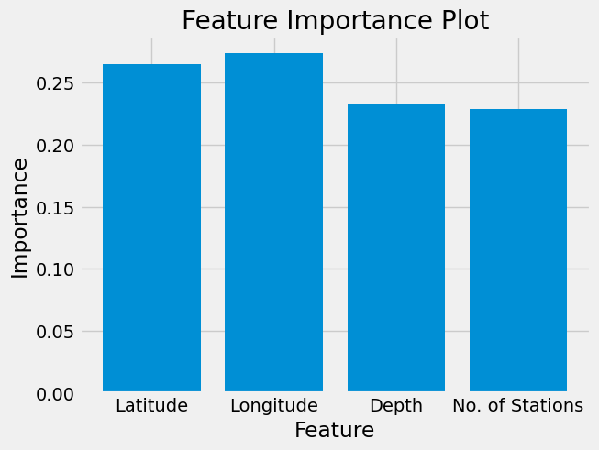
DATA VISULAIZATION

Slide 6
SPLITTING THE DATASET
to create the earthquake prediction model, we need to divide the data into Xs and ys which respectively will be entered into the model as inputs to receive the output from the model.
Here the inputs are TImestamp, Latitude and Longitude and the outputs are Magnitude and Depth. I’m going to split the xs and ys into train and test with validation. The training set contains 80% and the test set contains 20%:
x=final_data[[‘Timestam’,’Latitude’,’Longitude’]]
y= final_data[[‘magnitude’,’depth’]]
from sklearn.cross_validation import train_test_split
x_train,y+train,y_teat=train_test_split(x,y,test_size=0.2,random_state=42)
print(x_train.shape,x_test.shape,y_train.shape,x_test.shape)

Slide 7
THANK YOU

